Slide 1
AI applications in Finance
Lecture 8
Introduction to Neural Networks
22-Dec-2020
Indranil Dutta

Slide 2
Agenda – Session 8
Use of Machine learning in Finance
Key Takeaways
Use Case : Credit Card Fraud Detection.
Use Case : Bankruptcy Prevention.

Slide 3
Machine Learning Use Cases in Finance

Slide 4
Machine Learning in Finance : Use cases
Financial monitoring
Prevent instances like money laundering
Assistance with investment decisions
Able to gain market insights
Predict future from past data.
Process Automation
Chatbots, workflow automation, employee training
Secure Transactions
Detect those which are fraudulent
Credit card fraud detection (*)
Source: https://marutitech.com/ai-and-ml-in-finance/

Slide 5
Machine Learning in Finance : Use cases
Risk Management
Monitoring of credit risk (*)
Probability of not repaying loan outstanding
Trading
Able to detect patterns in real time.
Best prices for instruments being traded
Forecast future values (*)
Financial advisory
Robo advisors for suggesting investment portfolios, retirement plans to clients
Customer Data Management & Decision Making
Financial trends for customers
New products and services
Source: https://marutitech.com/ai-and-ml-in-finance/

Slide 6
Machine Learning in Finance : Use cases
Customer Service Level Improvement
Chatbots resolve customer queries
Offer personalized products / solutions
Bankruptcy Prevention (*)
Customer Retention
Design programs based on customer profiles
Maintain loyalty(*)
Marketing
Design marketing programs for customers
Prediction based on customer responses (*)
Source: https://marutitech.com/ai-and-ml-in-finance/

Slide 7
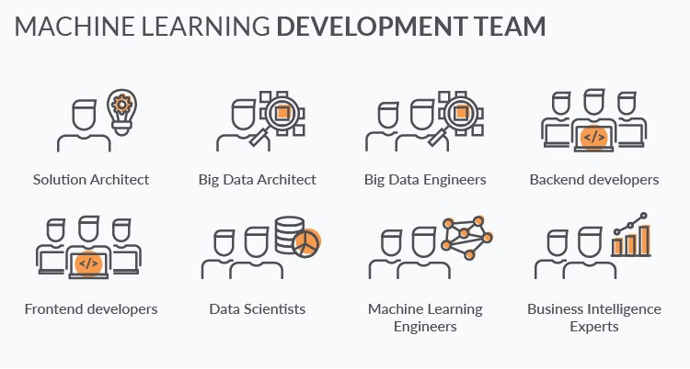
Machine Learning in Finance : Roles
Source: https://towardsdatascience.com/machine-learning-in-finance-why-what-how-d524a2357b56

Slide 8
Key Takeaways

Slide 9
Key Takeaways
Identify the problem
What type of issue do I have to solve?
Do I have to predict the future value of something ?
Supervised learning, regression/prediction models
Do I have to predict an outcome or category?
Supervised learning, classification models
Do I have need to understand relationships in the dataset?
Unsupervised learning, clustering models

Slide 10
Key Takeaways
Work with the data
Assess input data in terms of
Data file format -> comma separated values (csv), excel etc.
Separate data
Inputs to the model
Target output from the model
Data types -> numeric, binary etc.
Are there any missing data?
Data values
Is there a need to scale/un-scale the data?
Are there outliers
Can correlations be identified?
Do you have enough data for
Training the model – 60%
Refining the model – 20%
Testing the model – 20%

Slide 11
Key Takeaways
Choose the tool
Examine what tool is available
Code based (e.g. python based)
PC based application (e.g. Neural designer)
Cloud based platform (e.g. Aikko)
Each has its own requirements and level of automation
Automatic scaling of data
Automatic design of network
Understand the default settings and what you can customize
Understand what values/parameters you can change
Network values like - # of nodes, type of activation functions
Training values like – epoch, batch, loss measure, optimizing method

Slide 12
Key Takeaways
Implement the solution
Do you
Need to take the model as code to fit to a larger system?
Need to publish this to a website for others to interact as
Single input?
Multiple input?
Need it for your own assessment?

Slide 13
Use Case: Credit Card Fraud Detection

Slide 14
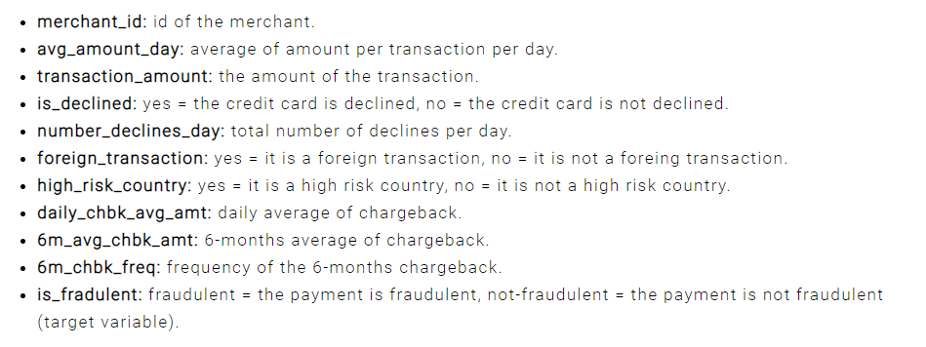
Neural Designer – Use Case – Credit Card Fraud Detection
Choose application type -> classification project
Fraudulent / Not fraudulent
Get the data set
creditcard-fraud.csv
Source : https://www.neuraldesigner.com/learning/examples/credit-card-fraud#ApplicationType

Slide 15
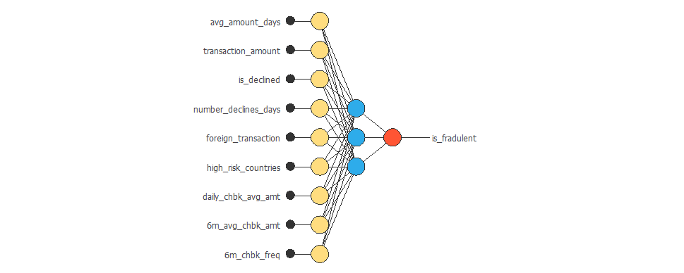
Neural Designer – Use Case – Credit Card Fraud Detection
Data instances
60% training
20% selection
20% testing
See data distribution
Balanced vs imbalanced
See the correlations
Build the network
Source : https://www.neuraldesigner.com/learning/examples/credit-card-fraud#ApplicationType

Slide 16
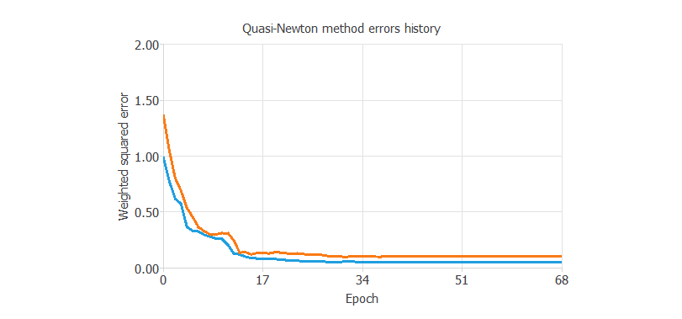
Neural Designer – Use Case – Credit Card Fraud Detection
Train the network
Loss index as default
Optimization as default
Model Selection
Order selection
Incremental model
Test the network
Source : https://www.neuraldesigner.com/learning/examples/credit-card-fraud#ApplicationType

Slide 17
Use Case: Bankruptcy Prevention

Slide 18
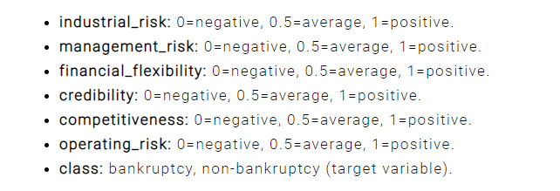
Neural Designer – Use Case – Bankruptcy Protection
Choose application type -> classification project
Bankrupt / Not Bankrupt
Get the data set
Bankruptcy-prevention.csv
Source : https://www.neuraldesigner.com/learning/examples/bankruptcy-prevention

Slide 19
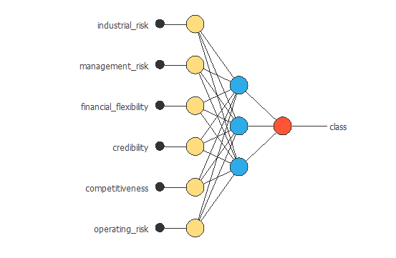
Neural Designer – Use Case – Bankruptcy Protection
Data instances
60% training
20% selection
20% testing
See data distribution
Balanced vs imbalanced
See the correlations
Build the network
Source : https://www.neuraldesigner.com/learning/examples/credit-card-fraud#ApplicationType

Slide 20
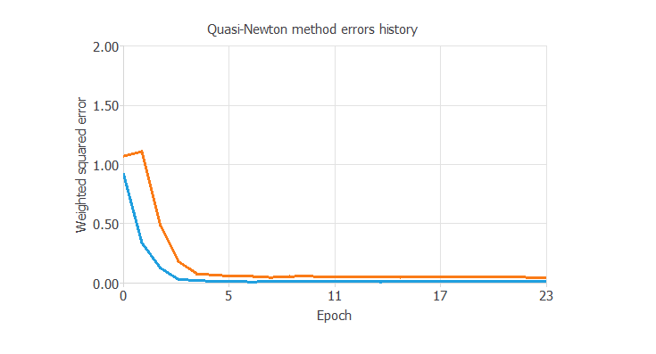
Neural Designer – Use Case – Bankruptcy Protection
Train the network
Loss index as default
Optimization as default
Model Selection
Order selection
Incremental model
Test the network
Source : https://www.neuraldesigner.com/learning/examples/credit-card-fraud#ApplicationType

Slide 21
References -------------------------------------------------------------
https://marutitech.com/ai-and-ml-in-finance/
https://towardsdatascience.com/machine-learning-in-finance-why-what-how-d524a2357b56
https://www.neuraldesigner.com/learning/examples/credit-card-fraud#ApplicationType
https://www.neuraldesigner.com/learning/examples/bankruptcy-prevention

Slide 22
Topics for next session
Neural Networks – Concepts and Practical examples

Slide 23
End of Session ------------------------------------------------------------------ Questions

